Slide 1
Automated Supermarket Checkout System (AutoScouts)
404 Team Not Found

Slide 2
Checkout Order(Use Case)
Description: Checkout Order is the first use case that the user will interact with. Checkout Order involves having the user scan items and interact with our project.
Classes:
<<Interface>> Checkout Interface – this will be the main interface that the actor(customer) uses to interact with your project. It will ask the user to scan items and then will display certain messages to guide the user through the process.
<<entity>> Item Catalog – This will be the database that stores all the items within the store. It allows the system to gain information about each item.
<<Business Logic>> Total – This is a simple class that will calculate the total of all the items that the actor has gotten.
<<entity>> Payment Method – This class is the link between the Checkout Order use case and the Pay by cash and Pay by Credit/Debit use cases.

Slide 3
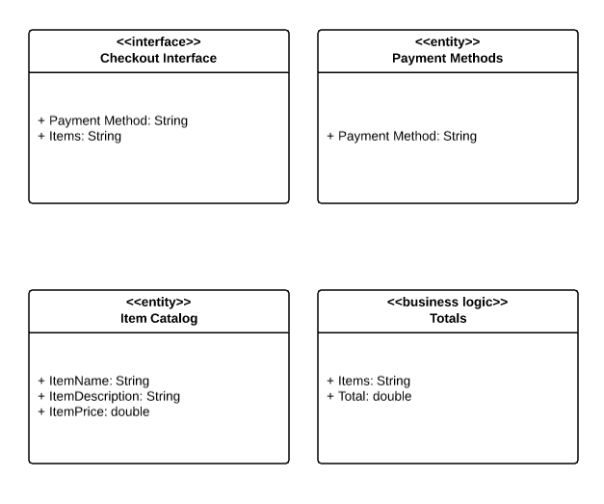
Checkout Order Static Model

Slide 4
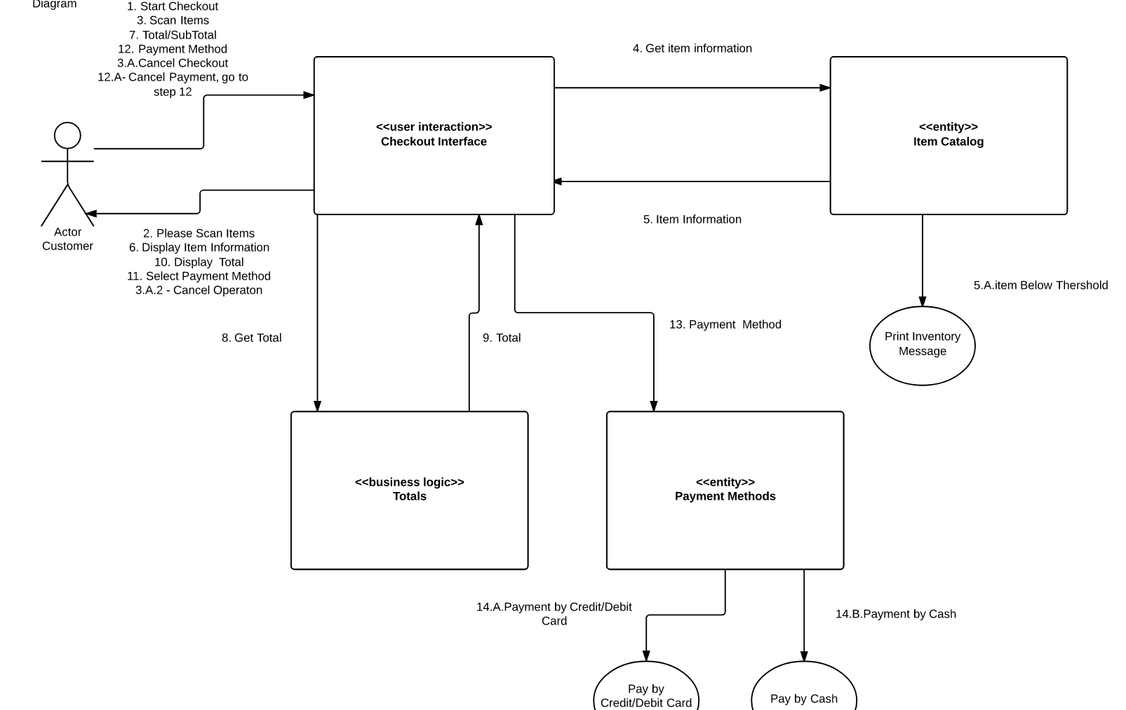
Checkout Order Interactive model

Slide 5
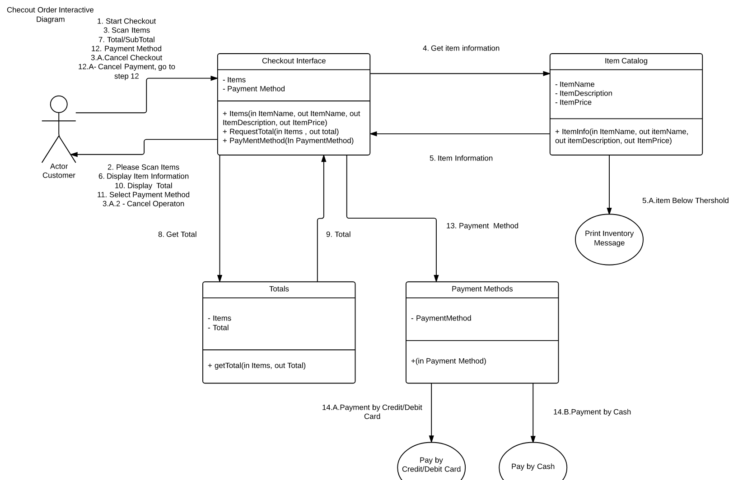
Checkout Order + Operations

Slide 6
Pay by Credit/Debit(Use Case)
Description: Pay by Credit/Debit will be chosen by the user in the Checkout Order use case. Asks the user to enter a credit or debit and then it will be approved by the bank.
Classes:
<<business logic>> Credit Card Process – That the user will interactive with, asks users to enter card info, then sends it to the bank to authorize.
<<entity>> Bank Interface – Sends request to the bank for approval. Bank outputs confirmation number
<<interface>> Credit Card Reader – Hardware object where the customer swipes the credit card and the object reads the account information

Slide 7
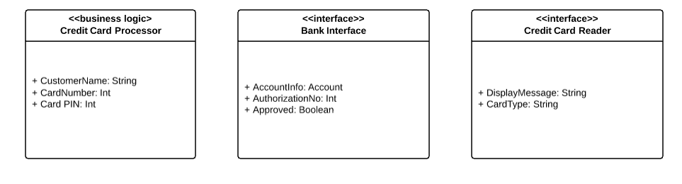
Pay by Credit/Debit Static Model

Slide 8
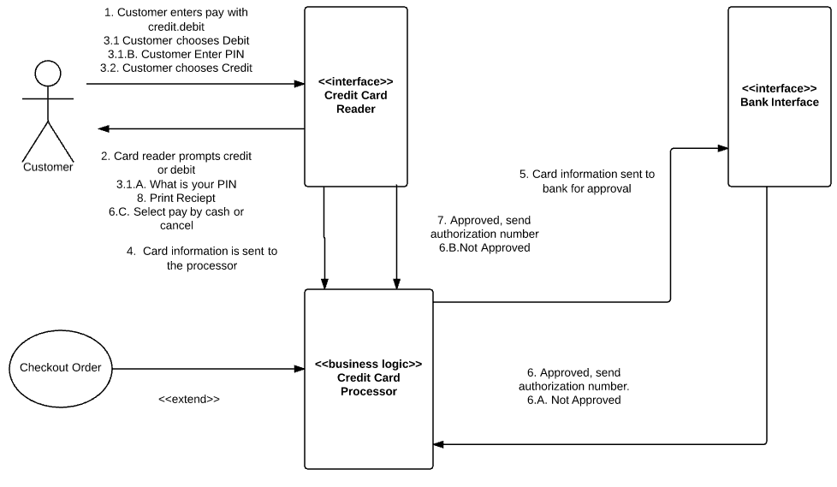
Pay by Credit/Debit Interactive Model

Slide 9
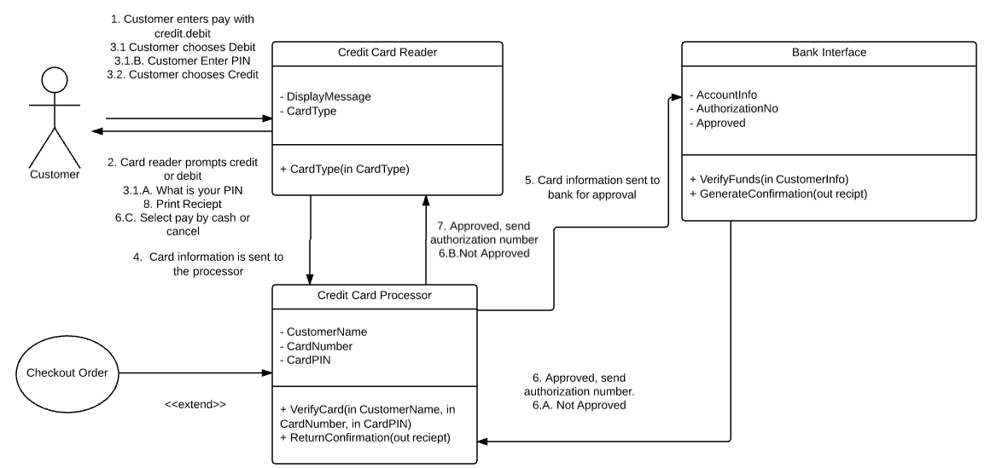
Pay by Credit/Debit + Operation

Slide 10
Pay by Cash(Use Case)
Description: Pay by Cash use case is chosen by the user in the Checkout Order use case. Pay by cash ask the user to insert a certain amount of cash and then will print out the receipt and given change back.
Classes:
<<Interface>> Bit Coin Reader – User inserts cash or coins and the bit coin reader takes that cash and outputs the amount to the program
<<business logic>> Payment – Does some basic math, computes the change that will be given back to the customer, also prints the receipt that contains authorization number, payment info, and items bought

Slide 11
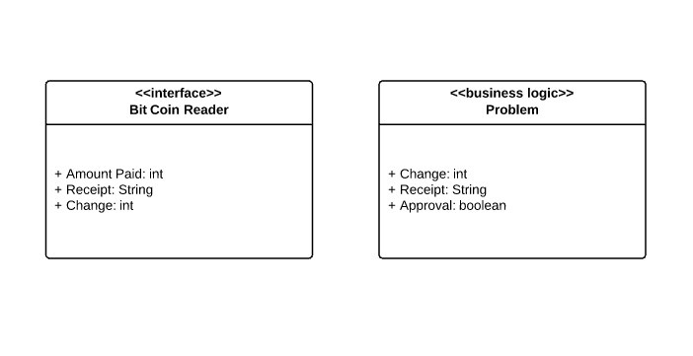
Pay by Cash Static Model

Slide 12
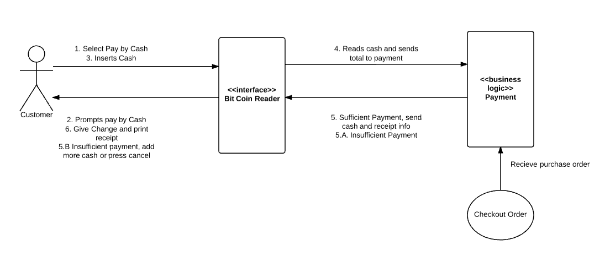
Pay by Cash Interactive Model

Slide 13
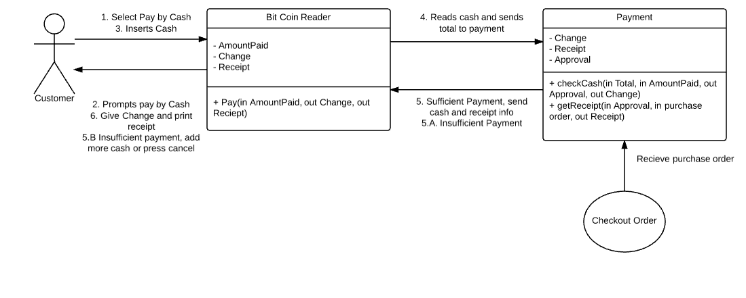
Pay by Cash + Operations

Slide 14
Restock Product Inventory(Use Case)
Description: This use case will have restocker as the actor. The restocker will enter the item and quantity that he will restock. If the item doesn’t exist, the item will be added to the database.
Classes
<<Interface>> Scanner – Scans the barcode of the item to look up item information.
<<interface>> Interface – Interface is the basic interface that will display item information and allow the user to restock product inventory
<<entity>> Inventory Database – Stores all inventory data. Allows for removal, addition, and change of items

Slide 15
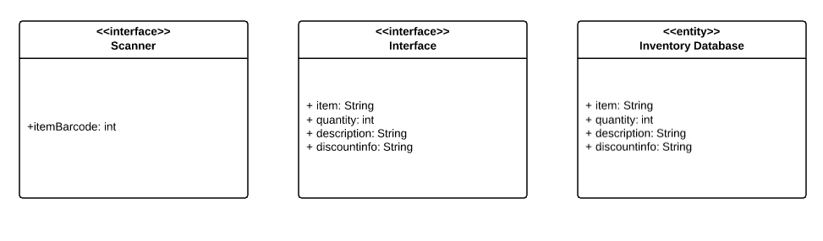
Restock Product Inventory Static Model

Slide 16
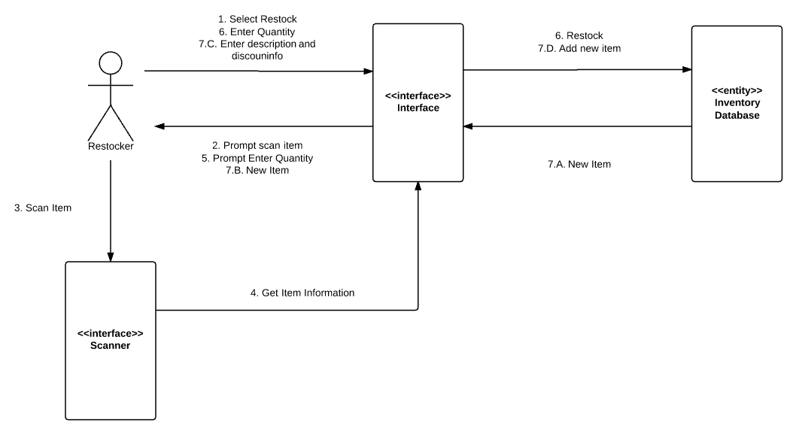
Restock Product Inventory Interactive Model

Slide 17
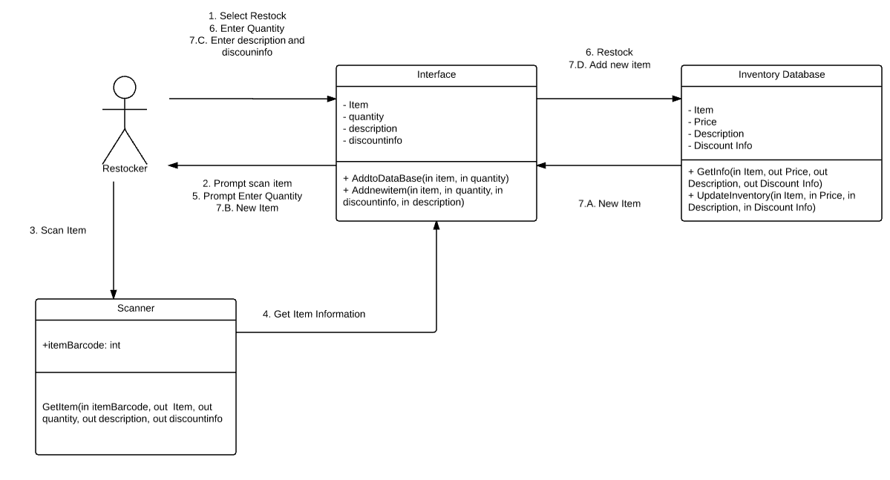
Restock Product Inventory + Operations

Slide 18
View/Update Product Inventory(Use Case)
Description: View/Update Product Inventory will have the manager as the actor. The manager will be able to view all products within the inventory and will be able to update the price, description, and discount info of particular products.
Classes:
<<interface>> View Inventory – Is the main interface class. Will allow manager to input item name, description, and discount info.
<<entity>> Inventory Database – Holds all item info. Will either output item details or update item details

Slide 19
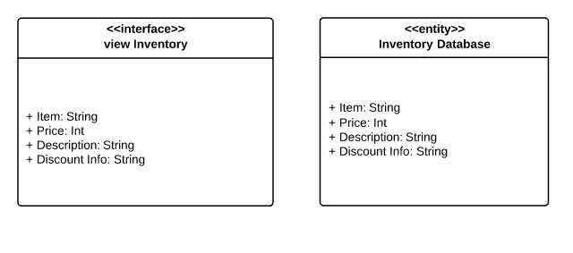
View/Update Product Inventory Static Model

Slide 20
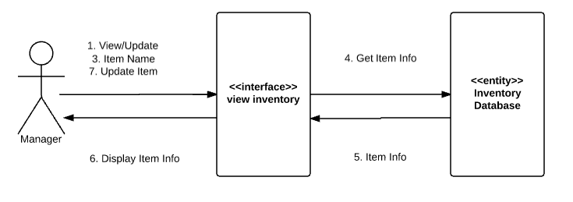
View/Update Product Inventory Interactive Model

Slide 21
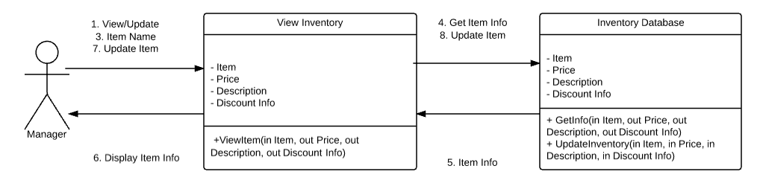
View/Update Product Inventory + Operations

Slide 22
Print Daily Report(Use Case)
Description: Print Daily Report will have a timer as an actor. Once the Timer hits midnight a report will be printed of items sold and revenue.
Classes:
<<Control>> Timer Interface – The system class will receive information about item sold and revenue. It will then send this information to the printer to get printed.
<<Interface>> Printer – Hardware that will print the information given to it by the system at midnight.
<<business logic>> Make Report- Creates the daily report by using data from the Inventory Database

Slide 23
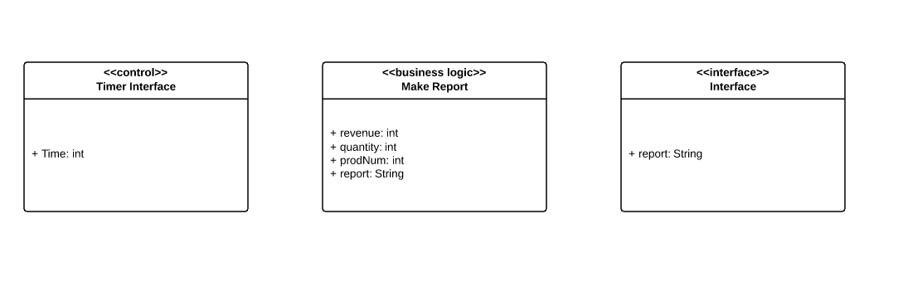
Print Daily Report Static Model

Slide 24
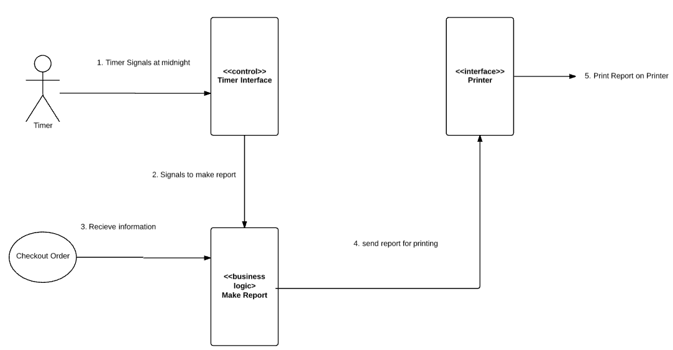
Print Daily Report Interactive Model

Slide 25
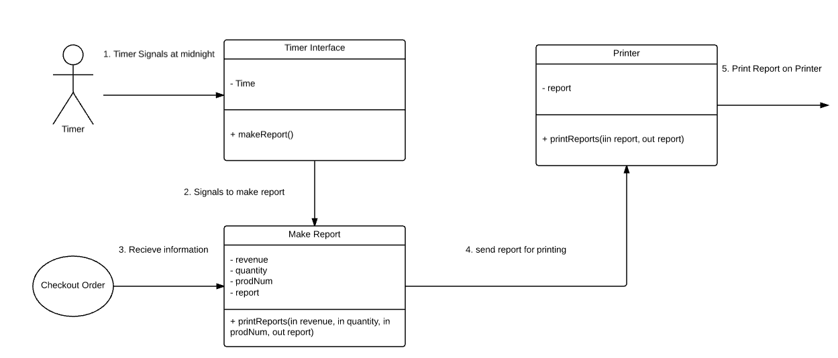
Print Daily Report + Operations

Slide 26
Print Inventory Message(Use Case)
Description: Print Inventory Message uses a timer as an actor. This use case is very similar to the Print Daily Report Use Case. At midnight Print Inventory Message will print a report of the inventory.
Classes:
<<Control>> Timer Interface – The system class will receive information about item sold and revenue. It will then send this information to the printer to get printed.
<<Interface>> Printer – Hardware that will print the information given to it by the system at midnight.
<<business logic>> Make Report- Creates the inventory message by using data from the Inventory Database

Slide 27
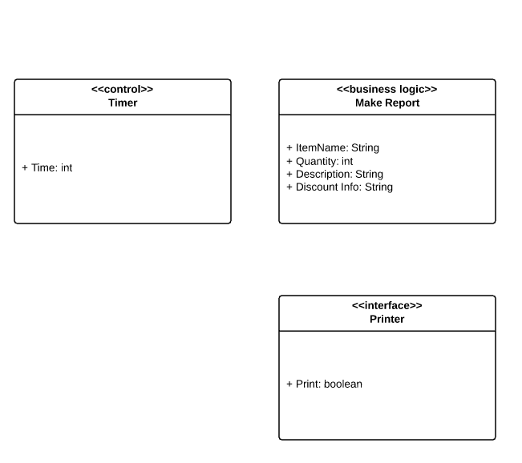
Print Inventory Message Static Model

Slide 28
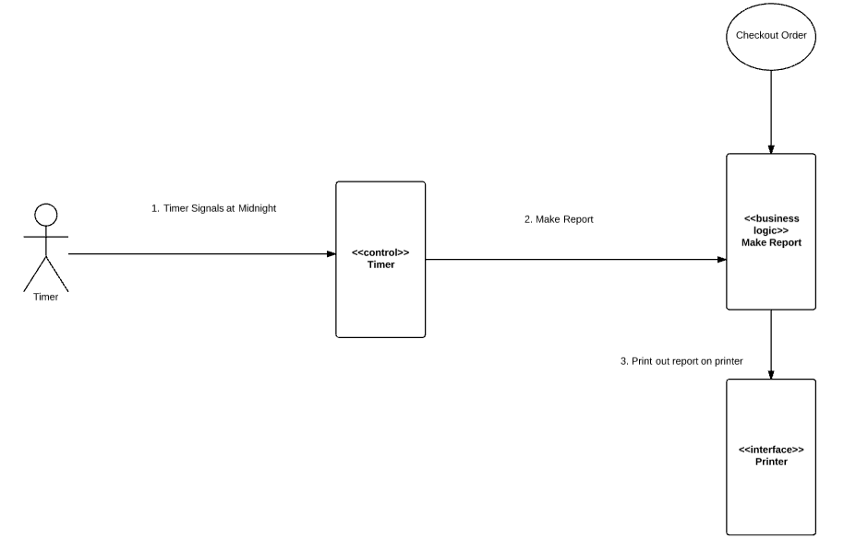
Print Inventory Message Interactive Model

Slide 29
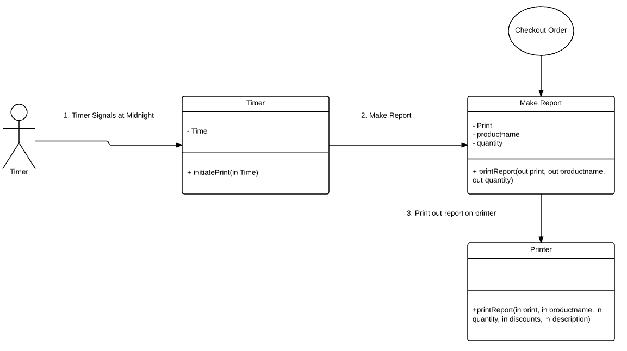
Print Inventory Message + Operations

